Slide 1
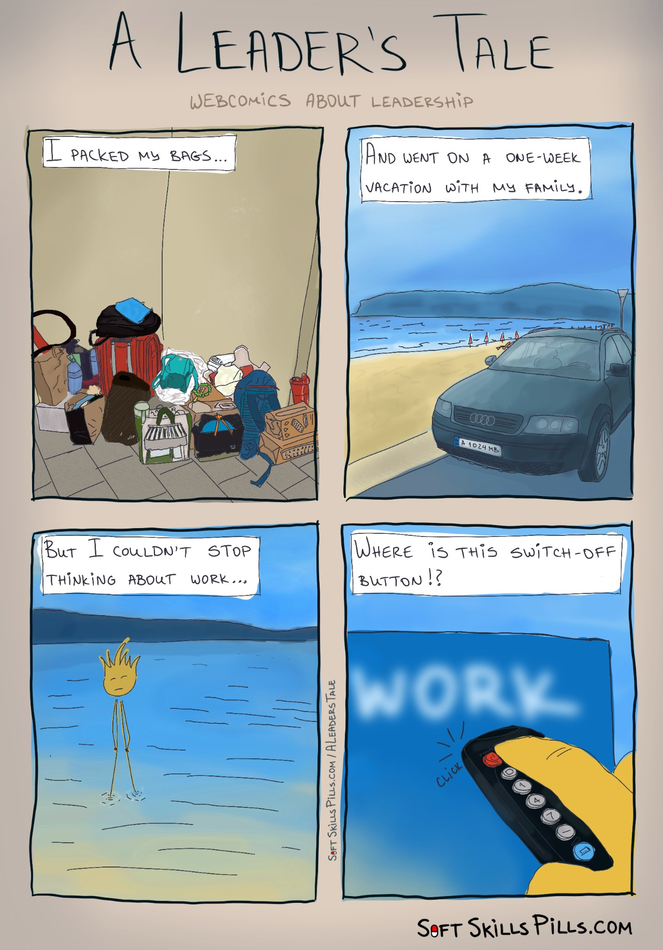

Slide 2
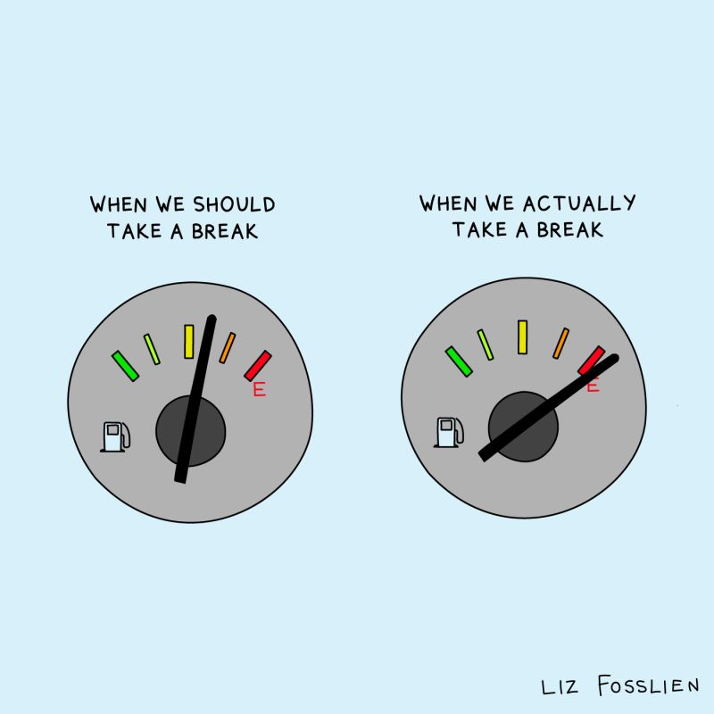

Slide 3
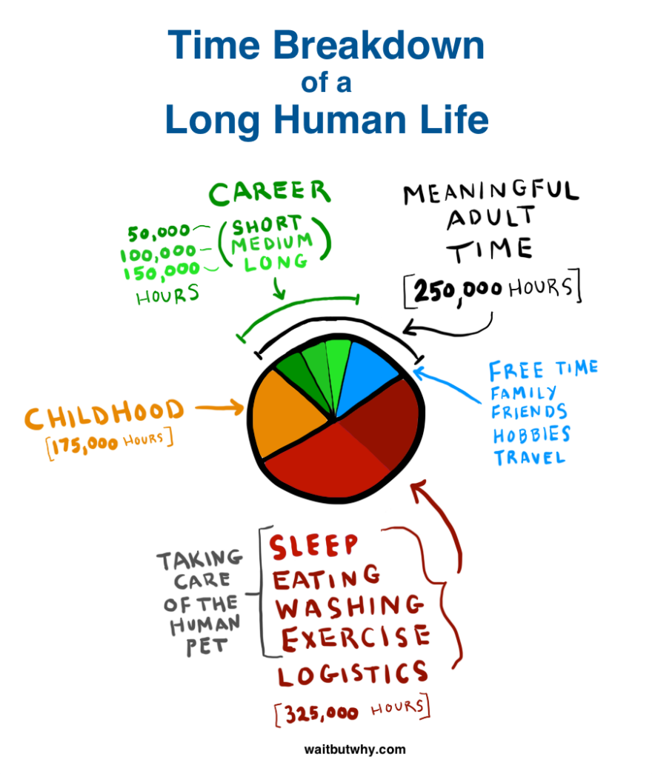

Slide 4
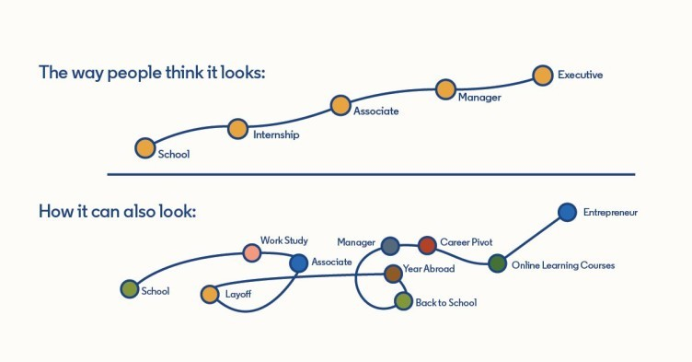

Slide 5







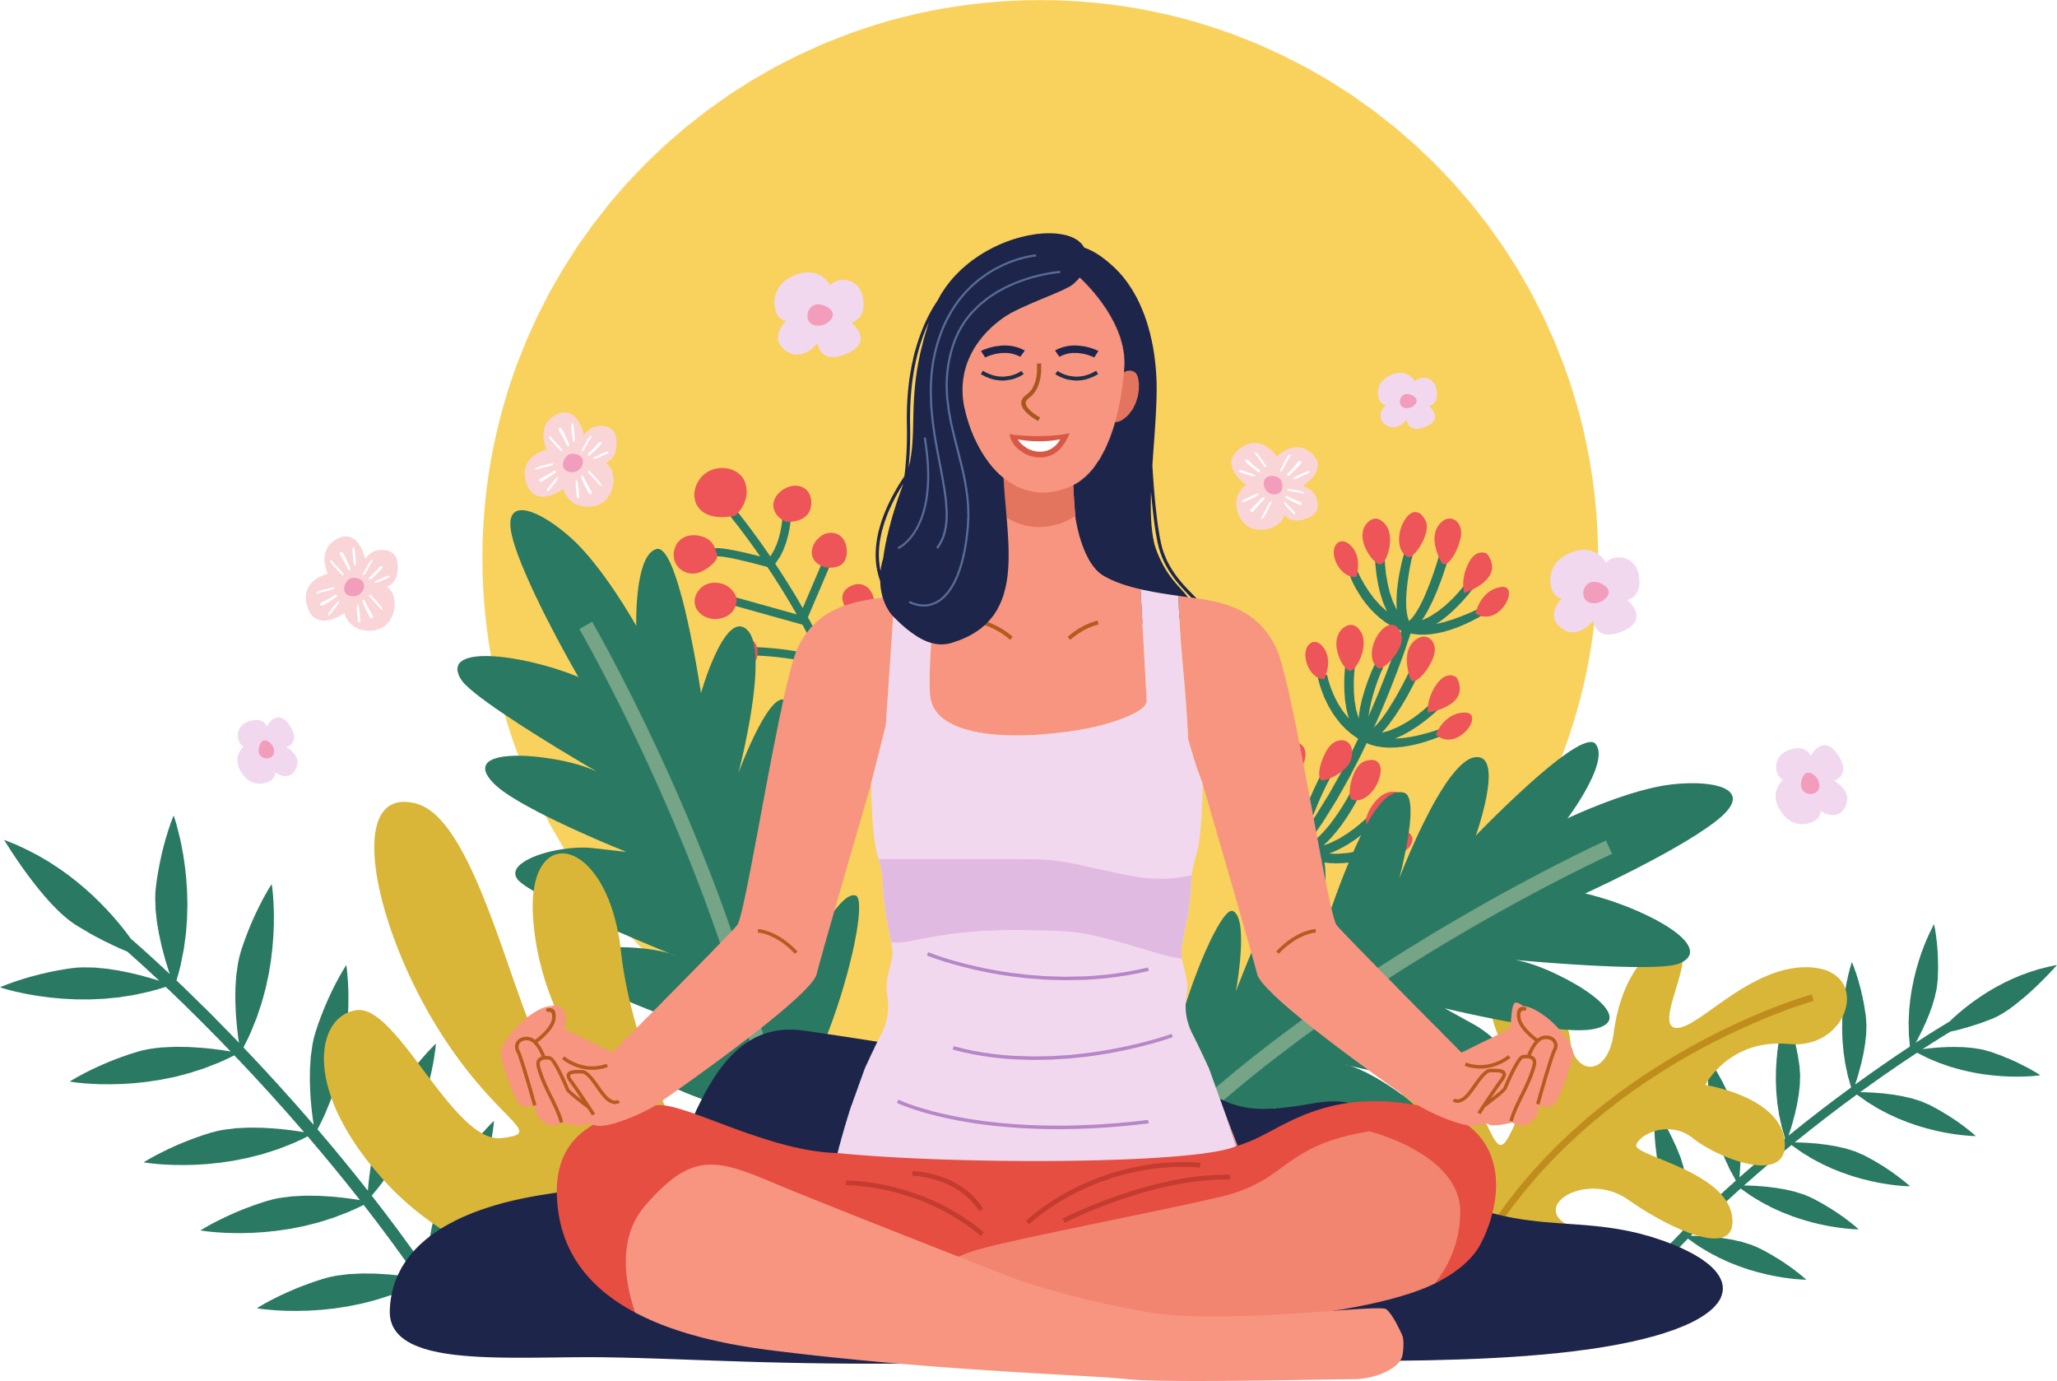





7 types of rest to avoid burnout
Physical Rest
Emotional Rest
Mental Rest
Spiritual Rest
Creative Rest
Sensory Rest
Social Rest

Slide 6
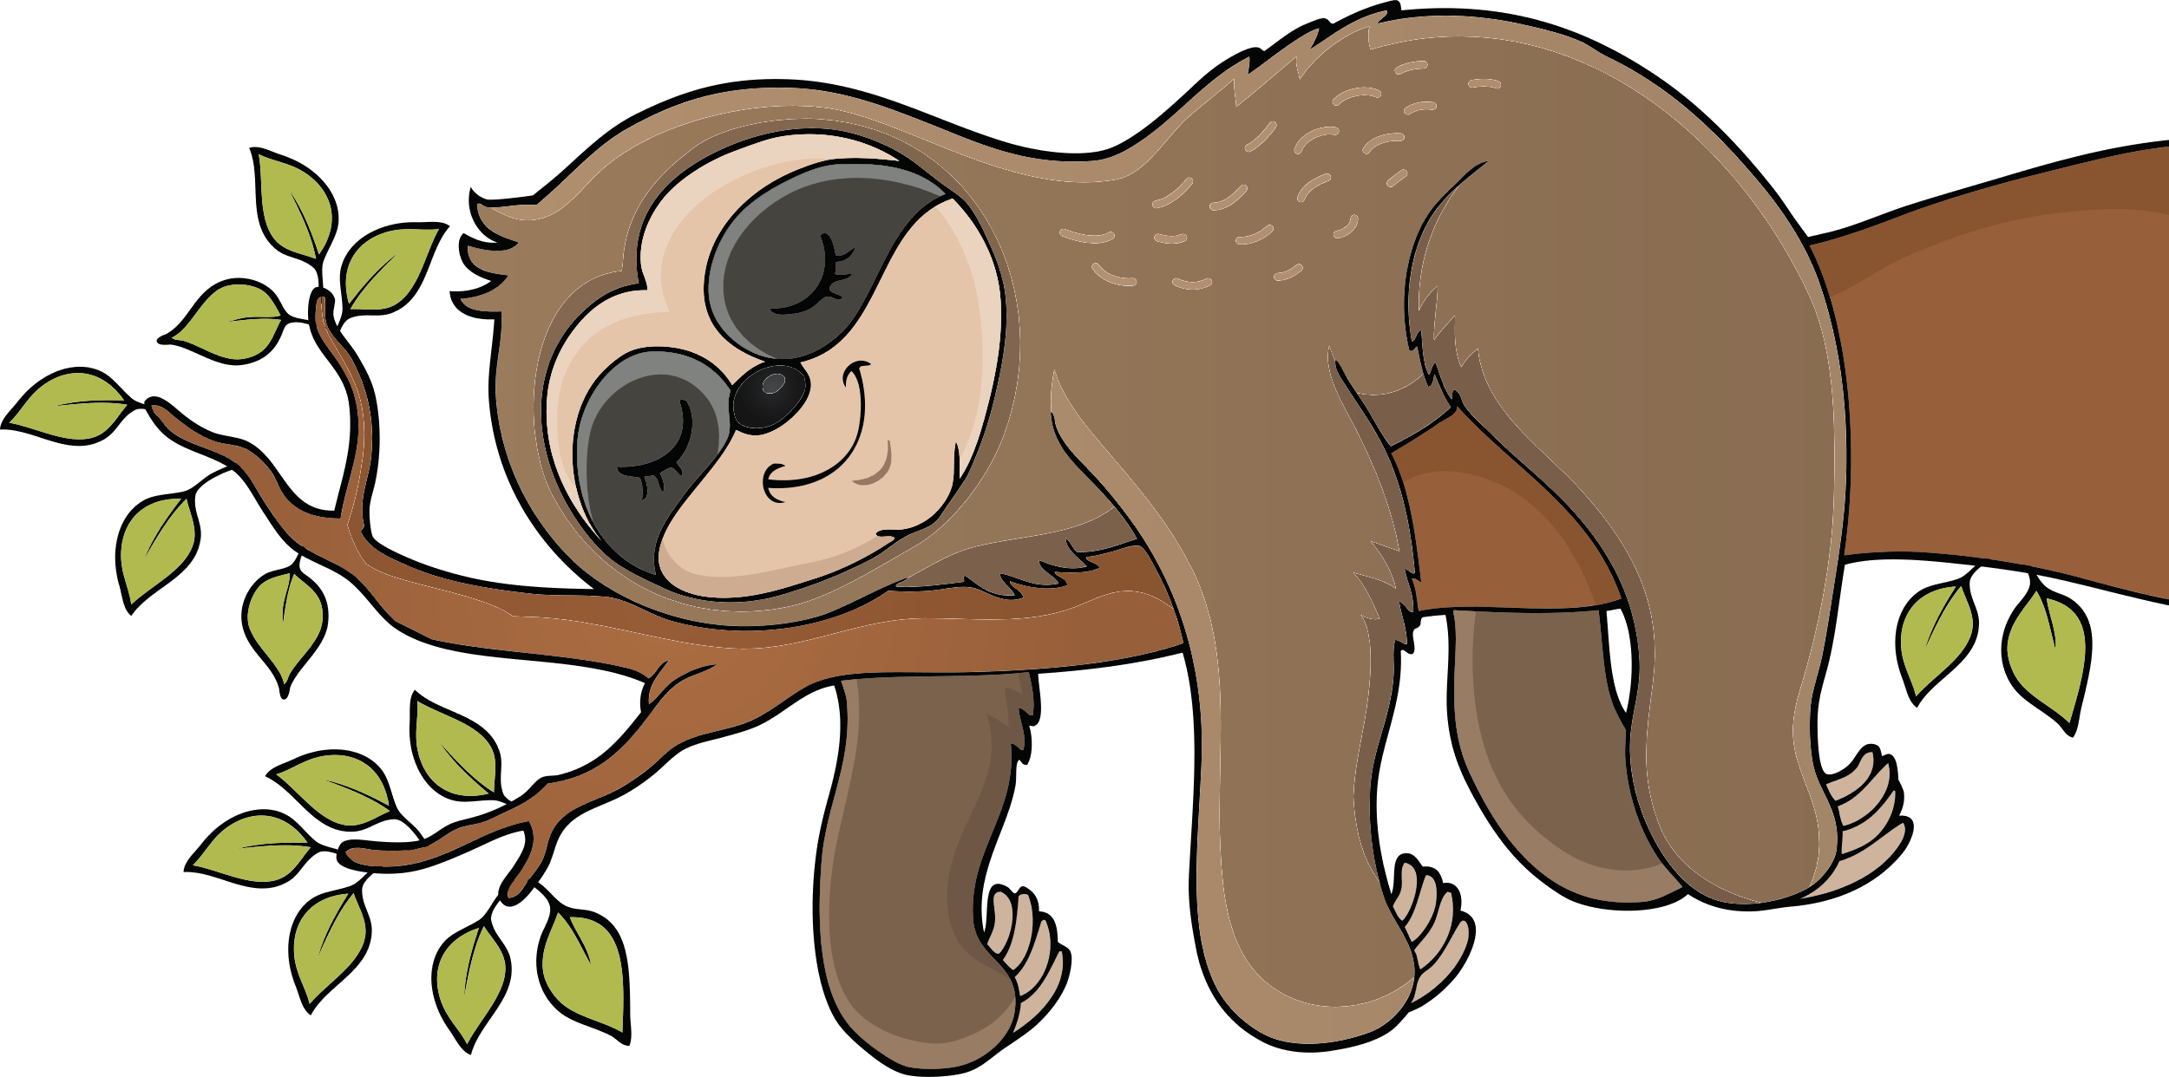
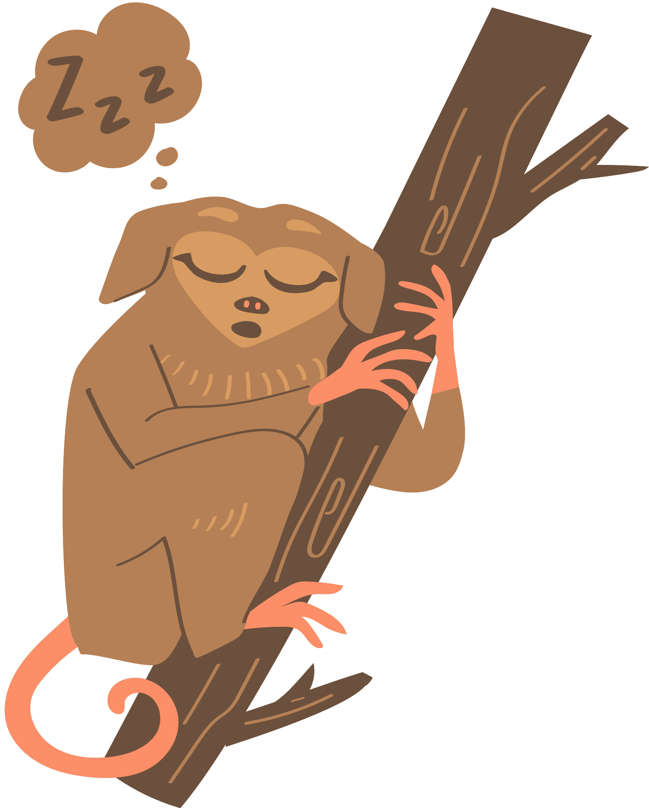


Physical Rest
Lack of sleep and overtraining deplete your body's energy.
Types of physical rest :
Passive and Active
Passive
• Sleep 7+ hrs. nightly
• Take power naps (as needed)
Active
• Stretch
• Massage
• Use an ergonomic setup

Slide 7



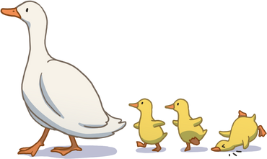
Mental Rest
Mental rest deficit is caused by overtaxing your thinking.
• Write down your to-dos
• Reference checklists (packing, groceries, etc.)
• Create a shutdown ritual to separate work and life
• Take a break from problem-solving
• Brain-breaks
• Music, silence, journaling

Slide 8




Emotional Rest
Emotional rest deficit occurs when you feel like you can't be authentic.
Ex: An airline attendant who must always smile, despite rude passengers.
• Spend time with people you can be authentic around
• Try speaking with a therapist to release emotional labor

Slide 9




Creative Rest
Appreciate beauty in any form, whether natural or human-created:
Natural
• Take in a sunrise or sunset
• Go for a walk in nature
• Be childlike and reawaken wonder
Human-created
• Visit a museum or art festival
• Engage with inspiring music, books, documentaries, etc.

Slide 10
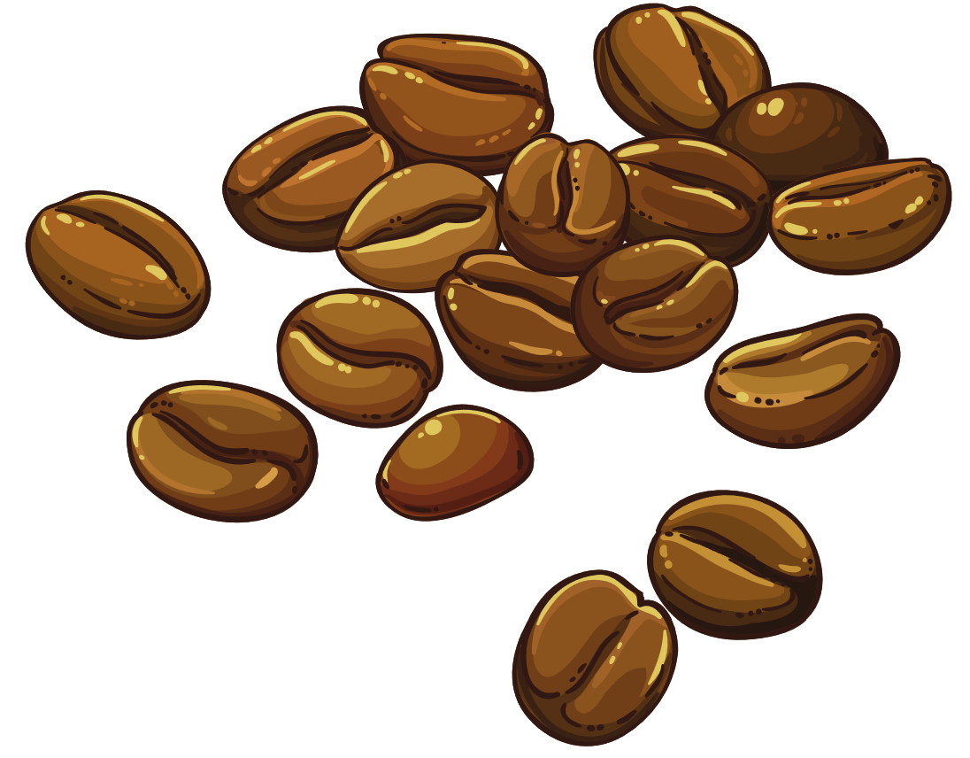




Sensory Rest
The modern individual is overstimulated.
• Take a break from social media
• Turn off notifications (sounds and visual alerts)
• Limit video meetings
• Set a relaxing evening ambiance (soothing music, candles, etc.)
• Turn down lights

Slide 11


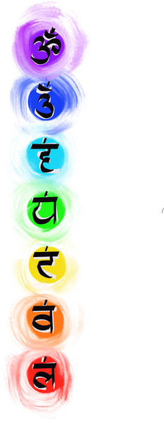

Spiritual Rest
Do things that provide a meaning.
Be part of something bigger than yourself.
• Volunteer
• Work a job that feels purpose-driven
• Participate in faith-based activities (if aligned to your belief system)

Slide 12




Social Rest
Evaluate your relationships.
• Spend more time with people who give you energy and provide support
• Spend less time with people who steal your energy
• If you're an introvert, block out time to be alone.
• Fill your own battery

Slide 13



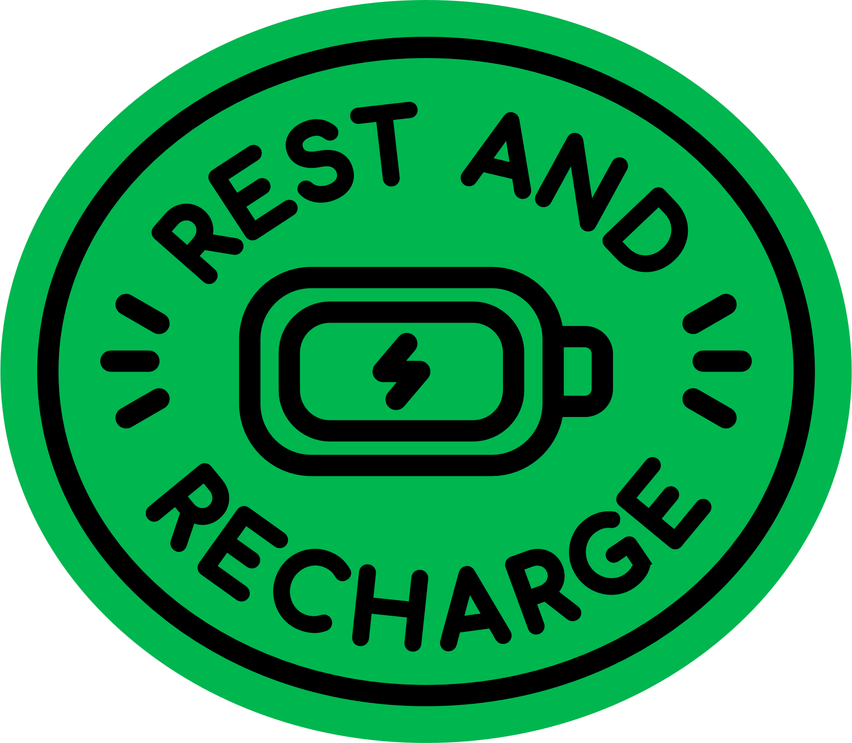


Dr. Saundra Dalton-Smith recommends starting with your 1-2 biggest rest deficits
(And not trying to eat the whole elephant at once).
Then, over time, create daily and weekly habits to get all 7.
Credits : Sacred Rest: Recover Your Life, Renew Your Energy, Renew Your Sanity
Made with by Vaishnavi

Slide 14
